Slide 1


Web Game Preparation -
Nothing to Hide
Data Protection Measures
Simple strategies you should know to protect your online accounts and data

Slide 2
Safe Passwords
Jetzt bist du dran!
Passwords may be hacked with (illegal) software which is mostly available for free. Usually, the software checks all possible letter combinations in milliseconds. That is why you should include different characters into your password and not choose simple words, names, or numbers only.
Task:
Choose a memorable word or a sentence
Keep the first letter of every word
Replace following letters with numbers: i=1, z=2, e=3, B=8, S=$
Replace one letter with following character: ! ? . , & - ( ) # + _ : ; @
Make sure that your password is at least 8 characters long. Add characters if necessary.
Example | Potential Password
I love safe passwords since I was born. | 1L§P$1w8.
I am ten years old, and what about you? | 1A10YO&way?
Notes:
Students should create 4-5 passwords and compare with students next to them.

Slide 3
Two-factor authentication
🔐 Something you know
📱Something you install
🧬 Something about you
security questions
select pictures (Captchas)
click&confirm „I am not a robot“
Authenticator-Apps
Codes sent by text message
Authentication devices
Biometric data
Iris recognition
Fingerprint
Notes:
Two-factor authentication (2FA) is an extra layer of security.
This means that, in addition to your password, you need a second piece of information to access your account—such as a code sent to your cell phone or an authentication app.

Slide 4


Phishing und Social Engineering *Worksheet available
📩 Most common types of phishing:
📧 Fake emails: These look like they’re from your bank or a well-known store and ask you to click on a link or “update your information.”
📲 Fake text messages or WhatsApp messages: Contain suspicious links with claims like “there’s a problem with your account or your delivery.”
🌐 Fake websites: These mimic real bank or social media sites but are actually copies designed to steal your information.
📞 Fake phone calls: Someone calls and pretends to be from customer support or your bank to trick you into revealing passwords or codes.
🎭 Common strategies::
Create a sense of urgency (“Your account will be blocked if you don’t act now!”)
Stir up fear or curiosity
Pretend to be someone trustworthy (a colleague, bank, or company)
👉 In other words: Social engineering is the trick; phishing is the trap.
Notes:
Worksheet ‘Phishing (Worksheets form the MECyS project).’
https://www.datapro.education/tools/

Slide 5
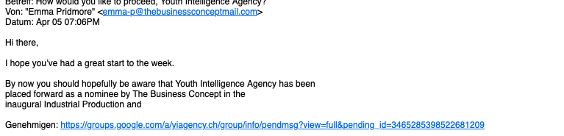
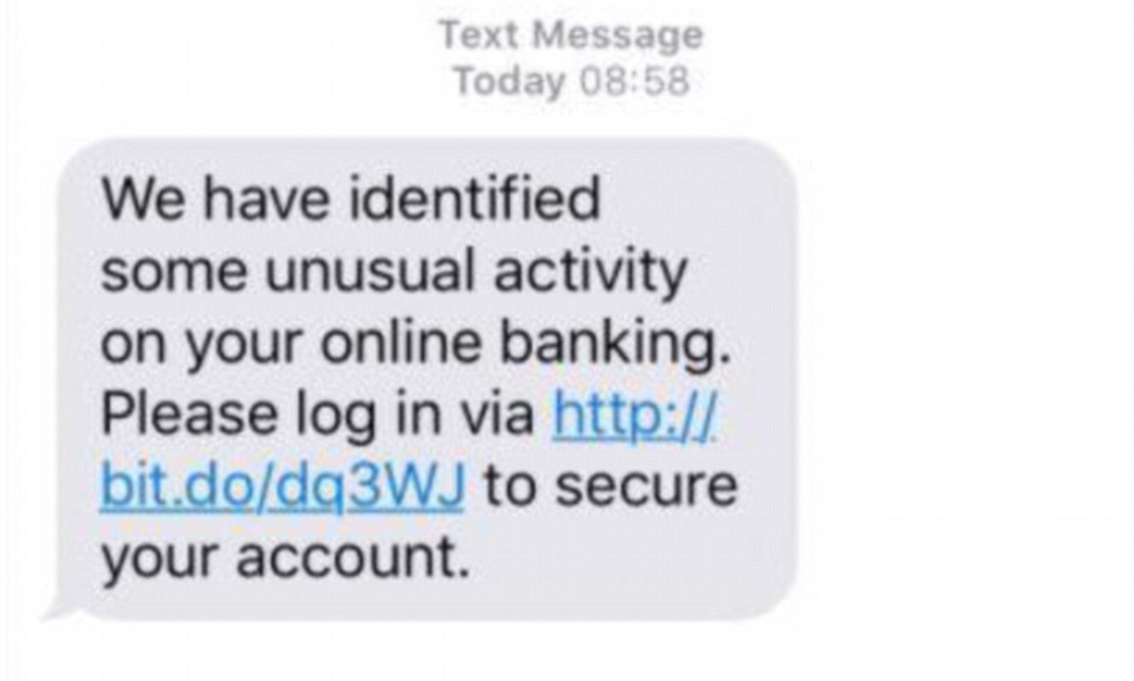
Examples
Discuss: how do we know this might be a phishing attempt?
Notes:
You might add further examples.

Slide 6
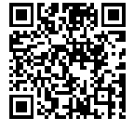





Create a quiz with the DataPro Assistant
*ask the DataPro chatbot!
Think of what you have learned about data protection. Choose one data protection measure and create a quiz for your group partner in class.
Prompting: ask the chatbot to generate a
Multiple choice quiz about your chosen data protection measure
to learn more about the measure and practice it
with five questions
with four different answers each
send the solutions/correct answers separately
Exchange quizzes with your group partner. Count how many answers you got right and compare.
www.vecteezy.com
Notes:
The DataPro-Agent is optimized for use on laptops or tablets with an updated Firefox, Safari, or Chrome browser. It does not collect data nor save chats. It only responds to questions about data protection.
→ https://datapro.cyber-geiger.com/

Slide 7

https://dataprogames.ph-freiburg.de/nothing-to-hide/
Notes:
Teachers: Please read the Game Guide first!
Play Nothing To Hide:
https://dataprogames.ph-freiburg.de/nothing-to-hide/

