Slide 1


Web Game Preparation -
Nothing to Hide
Privacy as a Human Right
Understanding the difference between privacy in everyday life and privacy online

Slide 2

What will we learn?
the extent of privacy online
data collected through platforms and apps
the difference of digital privacy/ privacy online to privacy in everyday contexts
👉 Digital privacy has a different extent
Notes:
TEACHER NOTE
🎯 Focus of the Module
This module deals exclusively with digital privacy.
👉 It does not cover:
Privacy in the home
Physical or personal spaces
Teachers should actively emphasize that:
Digital privacy works differently from privacy in everyday life.
Data is generated automatically online.
Content can be stored and shared.
“Private” does not necessarily mean “for my eyes only.”
Framing the Parent’s Role Correctly
It is important to make clear that:
Parents are part of the protection and support system.
Digital skills need to be learned.
Guidance and supervision are beneficial.
The goal is safe and responsible use, not complete freedom.

Slide 3

WHAT DOES DIGITAL PRIVACY MEAN?
Digital privacy means:
Understanding what data is being generated
Knowing who can see that data
Making conscious decisions about what information you share
It is about having control over your own data.
Just me
Who can see my data?
3. Me, other users, and the platform/app provider
2. Me and the platform/ app provider
Notes:
Discuss the 3 areas of digital privacy:
data is private to me = only I know about it
data is private to the public, but shared with platform providers = others may not see it, but my data might be processed, shared with and selled to third parties
data is public = I shared it on social media for everyone/ all social media users to see. It might be distributed or used without me knowing or consenting

Slide 4

The GDPR: Your data online, your rights
What rights do you have when using social media and digital platforms?
Discuss: Do you know about your rights under the General Data Protection Regulation (GDPR)? (Kahoot)
In groups of two: collect 5 rights you have concerning your data online
You have the right to…
KNOW | What information a platform collects about you Why it is collected and how it is used
ACCESS | Ask to see the data a company has about you
CORRECT | Request that incorrect information be fixed
DELETE | Ask for your data to be removed ("Right to be Forgotten")
CONTROL | Decide whether companies can use your data for certain purposes Change privacy settings and permissions
GET A COPY | Request a copy of your personal data
Notes:
Start with our Kahoot: Data Protection: Are you a GDPR expert? https://www.datapro.education/tools/

Slide 5
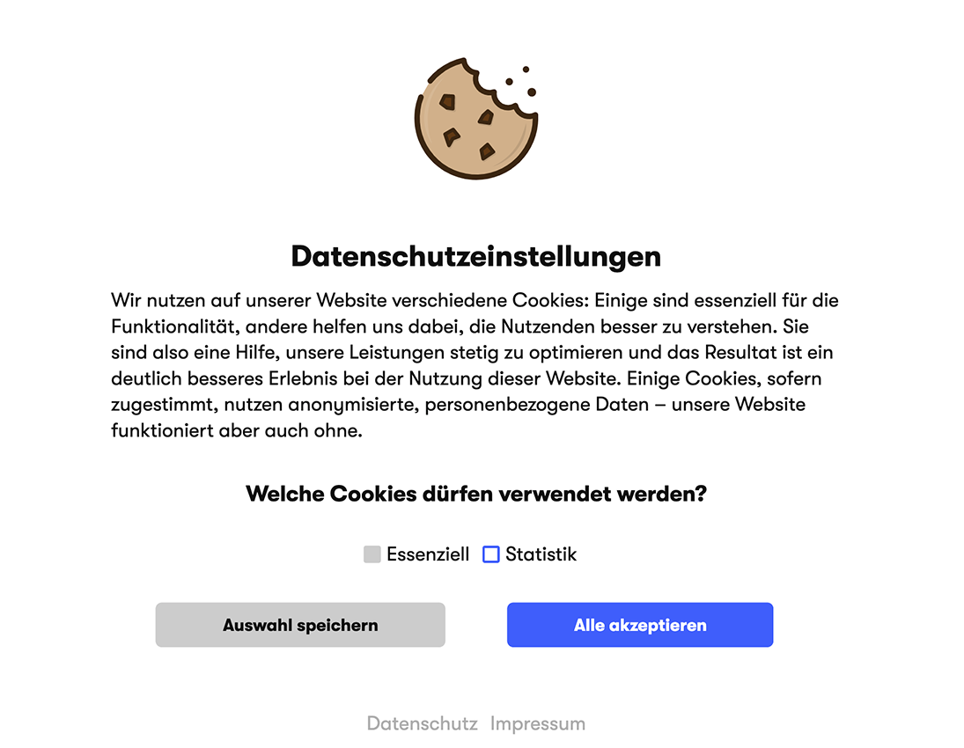
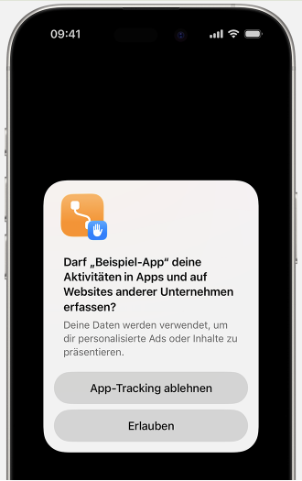



How do apps know what you are doing? Tracking
What happens in the background?
Apps & Websites use:
Cookies
Tracker
Analytics-Tools
In-App-Tracking
They can detect:
which web pages you visit online
how long you are staying on a web page
what you interact with by clicking
For example:
Notes:
🎮 Nothing to hide Game: Play Cookie-Game

Slide 6
Online ads just for you
*worksheet available (Worksheet Data Pro Webgames - Task 2)
🔍Discuss in class: why are ads so important?
Without personal data
➡️ Ads for everyone
➡️ small group of people is interested + will interact + will purchase
With personal data
➡️ Ads just for you
➡️ higher probability you will interact with content you like
➡️ higher click rate
➡️ higher profit
👉Companies pay more for personalized ads
Notes:
Explain why personalization leads to more platform interaction and screen time → money. Eg: regular ads = cost a lot of money to create, non specific, lower probability users will click nor buy products
Use Task 2 from our worksheet “Worksheet DataPro Webgames” available on our website in “for teachers” > ”training material” https://www.datapro.education/training-material/
personalized ads = costs money to create, higher probability of reaching the right customers → more effective

Slide 7

CONTEXT MATTERS
Discuss in class
Do you use social media?
Which apps do you use?
Do your parents know?
👉 Risks online are often not directly visible.
Notes:
Explain context of privacy beyond ‘rights’ and protection by the GDPR.
Encourage critical thinking: what do I want others to know about me? Do I have the right to share data about others? Is my profile public or private?
→ Preparation for Nothing to hide game, concerning children and teenagers up to 13 years of age

Slide 8
SHARING & AWARENESS

Slide 9


What does ‘share with everyone’ mean?
If you post with a public profile or to all users (not just friends), your data might not only be seen by strangers but also
copied
downloaded
edited
shared
re-uploaded
by other users and to other platforms.
The public on the internet is therefore
visible to all
easy to record, download, edit and forward
almost impossible to erase completely
*Kahoot ‘To post or not to post?’
Notes:
What does public mean in a non-digital vs digital context? Ask in class and collect examples from special social media apps/ platforms
Play Kahoot: To Post, or Not To Post? available on https://www.datapro.education/tools/

Slide 10




What is ‘public’ on the internet?
Public may mean
a public profile
a publicly poster photo/ video
a comment under a public video
a shared location
personal information in your bio/’about you’ section
💡How could a stranger combine small details and information from several social media accounts? *worksheet
Notes:
Ask in class: How could a stranger combine small details and information from several social media accounts?
Use Task 2. ‘Your data profile’ on worksheet ‘DataPro webgames’ https://www.datapro.education/tools/

Slide 11

Discuss: what could your data profile reveal about you?
Consequences
for strangers
for your content (photos, videos,...)
for your future
for your consumption behaviour (ads)
for others: family, friends
for people visible or tagged in your content
Notes:
After doing task 2. from the worksheet, groups may present their data profiles and discuss the risks & possible dangers to others
!Stress it is about awareness rather than about being afraid!

Slide 12
Discuss: what information can I trust online?
Checklist before you like, comment, or share content
? Who shared the information/ content?
? Do I know this person/ institution?
? Why has it been posted?
? Do I trust this information?
? Where can I confirm the information is correct?
→ Before you interact with content:
Pause
Breathe
Count to 5
Ask yourself: why do I want to share/interact with this?
*interacty: Unmaks the News!
Notes:
Explain that interacting with content (sharing, liking, forwarding) will help it spread more easily and rapidly over social media (algorithmic competence)
Play interacty game ‘Unmask the News!’ available on https://www.datapro.education/tools/

Slide 13
Decide: Interact or Ignore?
→ In the following slides you’ll see fictional posts forms social media. Decide if the information is trustworthy, if you should interact, like, share, comment, or ignore the content.

Slide 14

Decide: Interact or Ignore?
Notes:
Solution:
X Ignore
Why?
devalues professionals and science (doctors do not want you to know this)
source check: unknown ‘news channel’
overly catchy heading (‘shocking discovery’)
makes promises (‘burns 10kg in 7 days’)

Slide 15
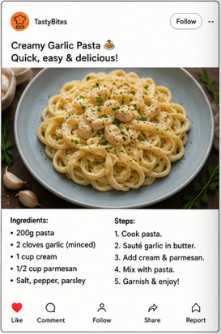
Decide: Interact or Ignore?
Notes:
Solution:
Ok to Interact

Slide 16

Decide: Interact or Ignore?
Notes:
Solution:
X Ignore
Why?
demonizes general, non-specific groups (‘companies’)
creates fear, generates panic, simulates urgency (‘cancer’, ‘protect your family’)
source check: unknown ‘health’ account
overly catchy heading (‘breaking)

Slide 17

Decide: Interact or Ignore?
Notes:
Solution:
X Ignore
Why?
unrealistic prizes
payment required to claim reward/ prize
no further information on selection procedure or cause given

Slide 18
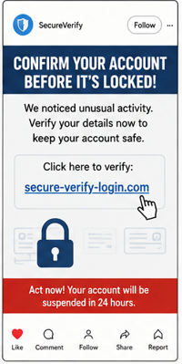
Decide: Interact or Ignore?
Notes:
Solution:
X Ignore
Why?
simulates urgency
includes an external link

Slide 19
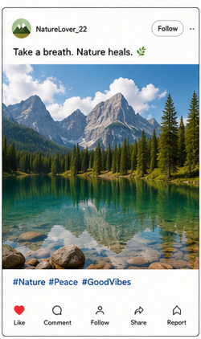
Decide: Interact or Ignore?
Notes:
Solution:
Ok to Interact

Slide 20

Decide: Interact or Ignore?
Notes:
Solution:
X Ignore
Why?
pyramide scheme
unrealistic promises
promises money

Slide 21

Decide: Interact or Ignore?
Notes:
Solution:
X Ignore
Why?
simulates urgency
pretends to know/ have access to ‘secret knowledge’
demonizes + generalizes a group ‘they’

Slide 22

Decide: Interact or Ignore?
Notes:
Solution:
Ok to Interact
Consider:
Do I know these people? Why do I want to interact?

Slide 23
Discuss in class:
what were common signs you should rather ignore a post?

Slide 24

https://dataprogames.ph-freiburg.de/nothing-to-hide/
Notes:
Teachers: Please read the Game Guide first!
Play Nothing To Hide:
https://dataprogames.ph-freiburg.de/nothing-to-hide/

