Slide 1
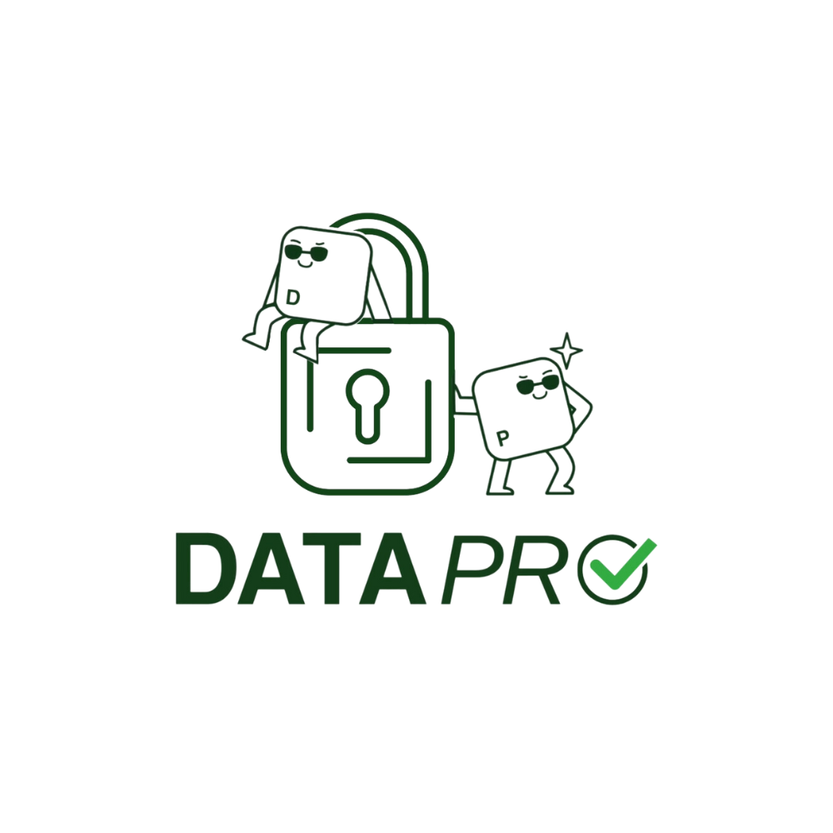

How do I decide what smart devices know about me?
C: Learn How to Protect Data with the Smart Home Challenge
Notes:
The topics covered in this lesson unit are based on the DataPro Curriculum https://www.datapro.education/curriculum-datapro/
and address the subject area “Applying Data Protection Methods,” specifically the following competencies:
- C.1 Identity Management
- C.3 Examine Online Trackability

Slide 2
GUIDELINES FOR USING THE SLIDES
We assume that you will adapt the slides provided here to serve your purposes.
The following slides include, among other things:
  Ways to Use the Accompanying Worksheet “DataPro Web Games Worksheet”
  Suggestions for activities using the DataPro AI bot. It is configured in such a way that conversations are not used for AI training (privacy!) and that it only answers questions related to the topic: https://datapro.cyber-geiger.com/
  Our web game, “Smart Home Challenge,” which helps students practice what they’ve learned after they’ve been activated and introduced to the topic : https://dataprogames.ph-freiburg.de/smarthome-challenge/
→ We recommend that you test the web game in advance for compatibility with the school’s Wi-Fi (bandwidth, restrictions on various websites) and read the accompanying “Game Guide.”
The learning objectives for this unit are based on the DataPro-Curriculum and are primarily designed to teach skills from Cluster C: Learning to Protect Data
You can find a further overview, including the specified learning objectives, in the accompanying lesson plan (syllabus): C – Protecting Data – Smart Home Challenge
Notes:
The topics covered in this lesson unit are based on the DataPro Curriculum https://www.datapro.education/curriculum-datapro/ and address the topic area “Protecting Data,” specifically the following competencies:
C.1 Identity Management, particularly raising awareness of data use: “Regularly question how and where personal data is used and shared, as well as the risks associated with it.”

Slide 3
OVERVIEW OF THE COURSE STRUCTURE
We suggest the following lesson plan—which can, of course, be adapted—based on the sequence of the slides:
Introduction: Identifying the “digital footprint” + whole-class discussion
Activity 1: Task Variation 3 from the accompanying worksheet “DataPro Webgames”
Working in pairs: Creating a “friend book entry” to document and contextualize the individual work completed earlier
Teacher-student discussion: Reflection on potential risks associated with the creation of personal data profiles by apps or online services
Activity 2: Play the DataPro web game “Smart Home Challenge.” Teachers are encouraged to review the accompanying game guide beforehand.
Conclusion: Feedback and reflection on what was learned and played during the whole-class discussion
Notes:
Depending on the skill level of the class and whether the unit is taught as a single or double period, the practice phases may be omitted.

Slide 4

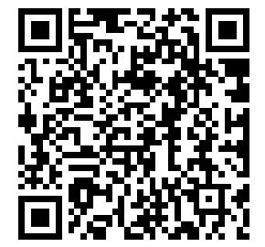
Digital Footprint
Imagine: If every click online and in apps were a step, how far would you have walked by now? Compare your results in pairs.
Now calculate your digital footprint: https://ppiippaa.github.io/datapro-datafootprint
Would you have estimated your digital risk to be just as high or low?
Notes:
Introducing the DataPro Tool “Digital Footprint Calculator,” available in English at https://ppiippaa.github.io/datapro-datafootprint/
for other languages check the calculator’s versions on our website under ‘Protecting your data’ https://www.datapro.education/tools/
Reflection on the issue of digital footprints: Introduction to lesson topics such as identity management, online traces, and the interconnectedness of data
Plenary discussion: How do the students assess the risk themselves—and how does the calculator assess it?

Slide 5

Data Connectivity
Ein Medium ist etwas, das Informationen überträgt oder speichert.
Smart devices, apps, and clouds: What do these terms have in common?
→ The service is based on the creation of personalized data profiles.
Companies analyze and process not only your click behavior on apps and digital platforms, but also your use of smart devices. The personal information we explored in the Digital Footprint Calculator helps smart devices predict your behavior and preferences more accurately, allowing them to suggest personalized services or products to you. You consent to the processing of your data in exchange for convenience and ease of use.
For example:
Your smartwatch is connected to your calendar and alerts you to upcoming appointments
You’re signed in to your Google Account and your streaming service accounts on your smart TV. The smart TV syncs your “Likes” and videos you’ve watched on YouTube and suggests movies and videos you might enjoy.
…
2. Find more examples as a class!
Notes:
Compilation of additional examples on the board during the whole-class session.
Transition to the topic of the Internet of Things (IoT):
Students understand that they not only leave digital traces online and in apps, but that data is also shared and linked between devices, apps, and the cloud.
It is important for students to recognize that data does not remain on a single device, but is
interconnected, combined, and shared.

Slide 6
Data Connectivity in the Internet of Things
3. Individual Assignment: You are developing SmartTime, an app for smartwatches. To ensure the app can provide the most relevant suggestions and features, it needs to get to know its users better. Decide what data you need from smartwatch users for this purpose.
SmartTime's planned feature | What type of data do we need? | How do we get the data?
Weather forecast | E.g., where are we located with the smartwatch? Location | E.g., access to the smartwatch's location data/GPS or entry of the location by the app user
Music recommendations | E.g., permission to access music apps, music preferences, which apps we use | E.g., synchronization with music apps (Spotify, SoundCloud, or iTunes), search history in browsers, music links shared in chats
Notes:
Worksheet “DataPro Web Games,” Activity 3: Data Networking in the Internet of Things (worksheet), available on our website https://www.datapro.education/datapro-webgames/ under “Class Material”
Note for teachers: Depending on class size and time constraints, you can also go directly to the web game.

Slide 7

Reflection: Data Connectivity in the Internet of Things
Discuss with the person sitting next to you: How much does SmartZeit know about you if you use all of the app’s features? Create a “friend book entry” with the information you’ve gathered. 2. As a Class: What risks might there be if you sync other apps or share a lot of personal data?
Notes:
This reflection should highlight that personal data can be used to create a fairly accurate profile, including the analysis of behavioral patterns (sleep, physical activity, health status, location, etc.). This personal data profile goes far beyond what a person’s friends and family know about them. Possible risks include, for example, the sharing of data with third parties through synchronization with other platforms or apps, or even unauthorized access to sensitive data if the app provider’s cloud is hacked.
At the same time, the app’s features can simplify daily life or offer convenience—so it’s worth critically weighing the benefits against the risks in class.

Slide 8

Web game: The Smart Home Challenge
Your smart home has been hacked and you can no longer unlock it! Find the smart devices, solve the puzzles, and adjust the privacy settings to regain access to your home. Along the way, you can earn points for making privacy-friendly choices as well as for the convenience and comfort your decisions provide.
https://dataprogames.ph-freiburg.de/
Notes:
Note to Teachers: Please read the Game Guide (in English) before using the game in class and, if necessary, check for technical compatibility with the school’s laptops and tablets (e.g., restrictions imposed by the administrator, bandwidth issues with the school’s Wi-Fi).

Slide 9

Web game: The Smart Home Challenge
Personalized data profiles aren’t just created about you through apps: Smart devices also collect, store, and process data using apps like SmartTime
In addition to cameras and microphones, smart devices usually have other sensors—such as those in a smartwatch that measure your heart rate—which allow them to create even more accurate profiles about you
Imagine you’re in a smart home—what kind of data profile could be created about you?
https://dataprogames.ph-freiburg.de/
Notes:
Introduction to the “Smart Home Challenge” web game: https://dataprogames.ph-freiburg.de/
Students should apply what they learned during group work to a new topic (smart devices)
Note to teachers: Please read the Game Guide (in English) before using the game in class and, if necessary, check for technical compatibility with the school’s laptops/tablets (e.g., restrictions by the administrator, bandwidth issues with the school Wi-Fi). Available at https://www.datapro.education/datapro-webgames/

Slide 10

Conclusion
(in a circle/plenary session)
What new things did I learn today about data profiles?
What surprised me?
Which data permissions would I like to adjust in my apps?

