Slide 1


How Is Data Linked and Turned into Money?
A: Understanding Digital Business Models with the Smart Home Challenge
Notes:
The topics covered in this lesson unit are based on the DataPro Curriculum https://www.datapro.education/curriculum-datapro/
and address the subject area “Data as a Good,” specifically the following competencies:
- A.1 Translate Data into an Asset
- A.2 Data minimization strategies
- A.3 Evaluate Intentions behind Data Monetization

Slide 2
GUIDELINES FOR USING THE SLIDES
We assume that you will adapt the slides provided here to serve your purposes.
The following slides include, among other things:
  Ways to use the accompanying worksheet “DataPro Webgames Worksheet”
  Suggestions for activities using the DataPro AI bot. This bot is configured in a way that conversations are not used for AI training (data protection!) and that it only answers questions related to the topic: https://datapro.cyber-geiger.com/
  Our web game, “Smart Home Challenge,” which helps students practice what they’ve learned after they’ve activated and been introduced to the topic : https://dataprogames.ph-freiburg.de/smarthome-challenge/
→ We recommend that you test the web-based game in advance to ensure compatibility with the school’s Wi-Fi (bandwidth, restrictions on certain websites) and that you read the accompanying “Game Guide.”
The learning objectives for this unit are based on the DataPro-Curriculum and are primarily designed to teach competencies from Cluster A: Data as a Good
You can find a further overview, including the specified learning objectives, in the accompanying lesson plan (syllabus): A—Understanding Digital Business Models—Smart Home Challenge

Slide 3
OVERVIEW OF THE COURSE STRUCTURE
We suggest the following lesson plan—which can, of course, be adapted—based on the sequence of the slides:
Introduction: Brainstorming on the IoT cartoon as a class
Group Activity 1: Exercise 1 from the worksheet on data permissions for digital platforms. Start with an analog approach, than combine with the DataPro Agent (a data protection-compliant AI chatbot)
Teacher-student discussion: Create a flowchart based on Task 1.
If applicable, work through: Task Variations 2 or 3 from the corresponding worksheet
Teacher-student discussion: What types of data do you consider particularly confidential? Do you use smart devices? What would you do if you had a smart home?
Securing knowledge: Play the DataPro web game “Smart Home Challenge.” Teachers are encouraged to review the accompanying game guide beforehand.
Conclusion: Provide feedback and reflect on what was learned and played during the whole-class discussion
Notes:
Depending on the skill level of the class and whether the unit is taught as a single or double period, the practice phases may be omitted.

Slide 4
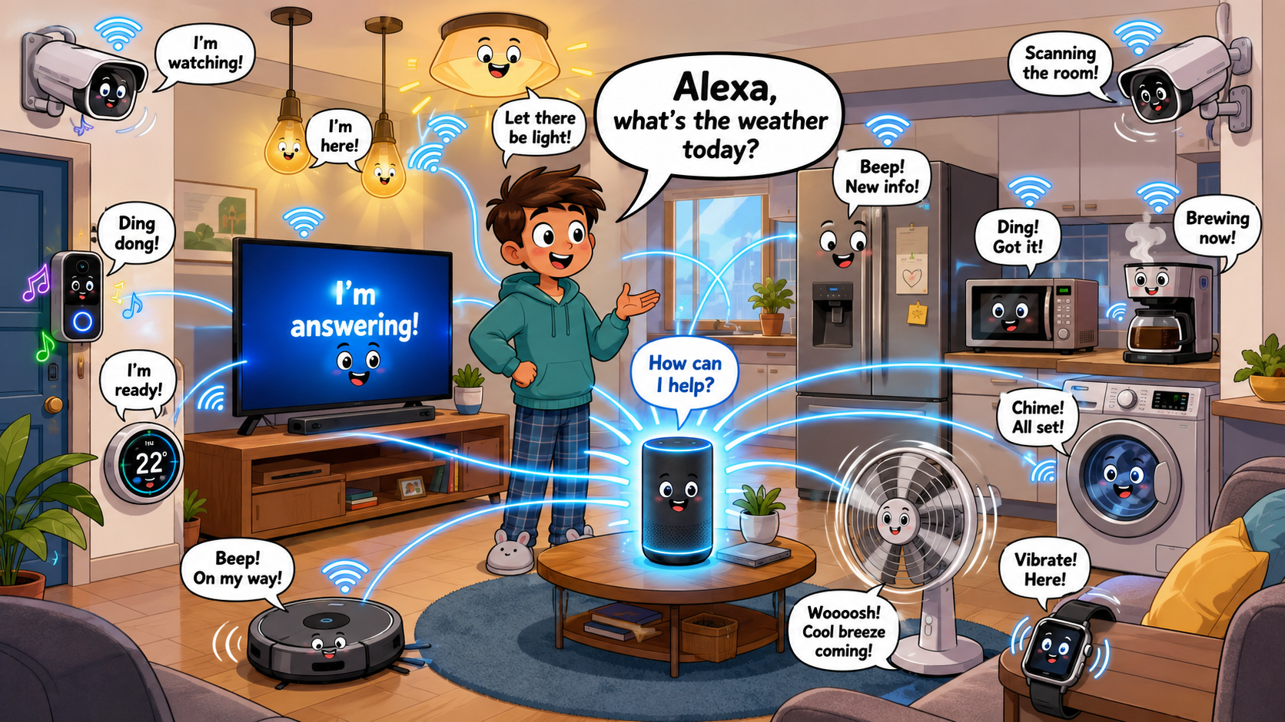
Pretty smart…
What do you see?
What do you think this picture is trying to express?
Where do you come across devices like these in your everyday life?
What is special about devices like these?
Remember the group assignment: What kinds of data can devices like these collect, and how?
Notes:
The IoT Problem Statement
- Connectivity in the Internet of Things
- Data collection and processing not only via smartphones, but also through various smart devices
- What data is collected, and how?

Slide 5

Group Assignment 1: Data and Data Connections
Group assignment in pairs [20 min] Phase 1: Determine the data flow
Choose a platform that you are familiar with and/or use.
What data permissions does the platform have, and what data do you voluntarily share there?
If a product is free, then what are we paying with?
Notes:
Teachers distribute index cards in two colors from the teaching kit.
For A: Students write the platform they want to analyze on the cards of one color.
For B: On the index cards of the other color, they arrange the “data connections” (Bluetooth, microphone, camera, contact list, etc.) around the platform.

Slide 6
Instructions for Parts A and B of Group Assignment 1.
  … How do we find out what data we’re sharing?
  Case study using your own phone or tablet!
  Android/iOS:
  Settings
  Apps/ Apps & Notifications
  See all apps/ Scroll
  Tap the app
  Permissions
Notes:
Case Study on Parts A and B of the Group Assignment: On the school tablet or students’ own smartphones, the data connections used by apps can be viewed in the device’s settings. Students can also access the apps’ own settings. They should also note down data and information shared for the purpose of the app, such as images, videos, profile names, etc.
! Even though most schools have a general ban on smartphones, we encourage conducting this case study under the supervision of a teacher. This can encourage students to reflect independently on their use of data in their everyday lives as well. !

Slide 7
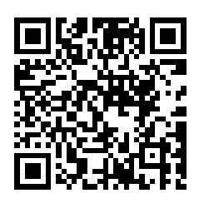

Group Assignment 1: Data and Data Connections
Phase 2: Identifying Business Models:
  c. Mind Map: Now sort the cards with the data types by topic. Think about what each type of data reveals about you and how companies could turn it into a “product.”
  d. Create a quiz for your group partner using the DataPro chatbot. The prompt should include the following:
  5 multiple-choice questions
  The corresponding answers will be sent separately (only you can see them, not your partner)
  Quiz content: List the data types from Parts A and B and figure out how the collected data can be monetized
https://datapro.cyber-geiger.com/
Notes:
C: Students should now use the collected data connections to deduce what the actual product behind the service is. How does the business model work? Data = money—what data does the platform process, and how is it turned into money?
D.Playful use of digital tools: Instead of merely retrieving information, students here creatively explore how digital tools can be used for learning. The DataPro Agent, our privacy-compliant chatbot for the classroom. Here, students can enter the collected data permissions and ask how these can be “turned into money.” The DataPro Agent is privacy-compliant and does not feed any conversations into the learning data. It answers only questions related to data protection topics. This makes it ideally suited for use in the classroom. The conversation ID can be copied so that the same conversation can be accessed later. The bot can be set to English via the language settings in the upper right corner. See → https://datapro.cyber-geiger.com/
D: Depending on class size, two groups of two students can discuss which data their chosen platform uses and identify similarities and differences.
Finally, the teacher can identify “personalization” as a common feature resulting from data collection (transition to the next part of the lesson).

Slide 8
Group assignment 1: Whiteboard presentation in plenary session
Platform
  … If a product is free, then what are we paying with?
  🡪 The “currency” usually comes from the information we provide to the platform
  Phase 3: Flowchart on the board
  Which platforms have you analyzed? What data do you share? How does that turn into money? As a class, create a flowchart showing all the intermediate steps “from data to product.”
Shared Data/Permissions
Product Types
Notes:
E: E: With the teacher’s guidance, a flowchart can now be drawn on the board. The groups report on the platforms they analyzed, the data permissions they identified, the data shared voluntarily, and the results from the quizzes they created. The next slide provides teachers with examples of flowcharts. In addition, the worksheet “Data as Capital—Business Models” can be used as a resource: https://www.datapro.education/wp-content/uploads/2025/06/A-AB-Daten-als-Kapital_Worksheet.pdf

Slide 9
Suggestion for Teachers: Flowchart
Platform
    Platforms: Instagram, TikTok, YouTube, Google Account →
    Shared content and granted permissions: Profile name, profile picture, live location, clipboard, synced with Spotify, Google Account, etc., microphone and camera, uploaded photos and videos, birthday, registered email address and cell phone number, address/place of residence, likes and comments, forwarded/shared content, …→
    Personalized data profile: What do I like, what are my interests; Behavioral data profile: When am I online, how do I interact with content, what do I click on, how long do I view something, …; Location-based data profile: Where do I spend my time, where do I go repeatedly, which places have I already visited; →
    Digital product: Target audiences for advertisers (ads tailored as closely as possible to you/your interests/your behavior); Attention/screen time: What do I like, and when do I stay on the platform longer (→ consume even more content → see more ads); Subscription model (ad-free experience with subscriptions like Spotify or YouTube, additional features); Long-term retention (e.g., content is perfectly tailored to my tastes, or I don’t cancel my subscription because it offers additional features)
Shared Data/Permissions
Product Types
Notes:
E: Example of a possible flowchart. In addition, use the worksheets and posters from ‘Making money with data’ at https://www.datapro.education/training-material/

Slide 10
Task Variation 2: Personalized Data Profiles
Task 2: What kind of profile can be created from our data? (WS)
What kind of data profile might your chosen platform have? Using the information you collected about shared data from Task (1), fill out the following data profile about your partner. Include only the information that he or she shares with digital platforms. Do not include any information that you know but did not learn through Group Work (1).
Notes:
Afterward, students can complete another exercise (either Exercise 2 or 3) from the corresponding worksheet. Depending on class size and time constraints, you can also move directly to the next section, “Smart Devices,” to introduce the web-based game.

Slide 11

Plenary Session
Do you know what data you share with these platforms? What types of data do you consider particularly confidential?
Notes:
Introduction to the Internet of Things

Slide 12

Web game: The Smart Home Challenge
Personalized data profiles aren’t just created about you through your smartphone or laptop.
Smart devices also collect, store, and process data—and can thus learn even more about you.
Imagine you’re in a smart home—what data permissions do the smart devices have? What kind of data profile could be created about you?
Is privacy more important to you, or is being able to use all the features of the smart device?
https://dataprogames.ph-freiburg.de/
Notes:
Introduction to the “Smart Home Challenge” web game: https://dataprogames.ph-freiburg.de/
Students should apply what they learned during group work to the new topic (smart devices)
Note to teachers: Please read the Game Guide (in English) before using the game in class and, if necessary, check for technical compatibility with the school’s laptops/tablets (e.g., restrictions by the administrator, bandwidth issues with the school Wi-Fi). Available at https://www.datapro.education/datapro-webgames/

Slide 13

Web game : Die Smart Home Challenge
Your smart home has been hacked and won't open anymore! Find the smart devices and adjust their privacy settings to unlock the smart home. As you do so, you can earn points in the “Privacy” and “Comfort” categories based on your decisions. Can you manage to unlock the smart home?
https://dataprogames.ph-freiburg.de/
Notes:
Note to Teachers: Please read the Game Guide (in English) before using the game in class and, if necessary, check for technical compatibility with the school’s laptops and tablets (e.g., restrictions imposed by the administrator, bandwidth issues with the school’s Wi-Fi).

Slide 14

Conclusion
(in a circle/plenary session)
What have I learned today about data connections?
What surprised me?
Which data permissions do I want to adjust on my smartphone?

